Slide 1
MAGNETIC TAPE

Slide 2
Magnetic Tape
Magnetic tape is one of the oldest technologies for electronic data storage.
While tape has largely been displaced as a backup storage medium, it remains well-suited for archiving because of its high capacity, low cost and long durability.
Consists of a plastic ribbon onto which a layer of magnetic material is glued.

Slide 3
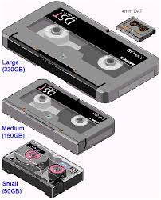
Magnetic Tape

Slide 4
Magnetic Tape
In magnetic tape only one side of the ribbon is used for storing data.
It is sequential memory which contains thin plastic ribbon to store data and coated by magnetic oxide.
Data read/write speed is slower because of sequential access.
It is highly reliable which requires magnetic tape drive writing and reading data.
The width of the ribbon varies from 4mm to 1 Inch and it has storage capacity 100 MB to 200 GB.

Slide 5
Advantages
These are inexpensive, i.e., low cost memories.
It provides backup or archival storage.
It can be used for large files.
It can be used for copying from disk files.
It is a reusable memory.
It is compact and easy to store on racks.

Slide 6
Disadvantages
Sequential access is the disadvantage, means it does not allow access randomly or directly.
It requires caring to store, i.e., vulnerable humidity, dust free, and suitable environment.

Slide 7
Thank You

